Slide 1
Electronic Timesheet User Manual
Massachusetts Participant Directed Program

Slide 2
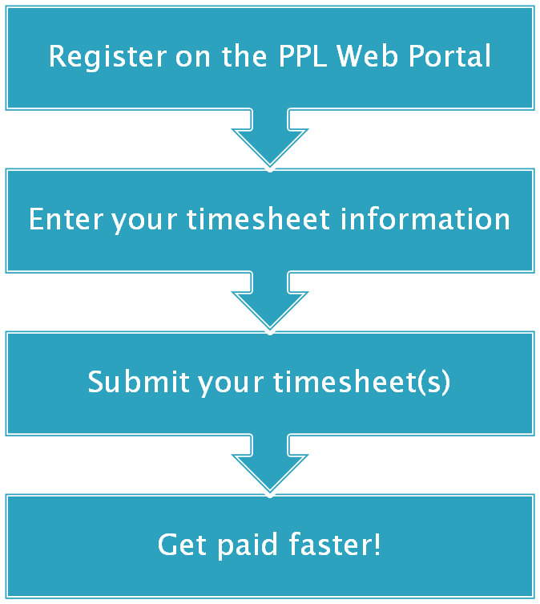

Slide 3
User Registration

Slide 4
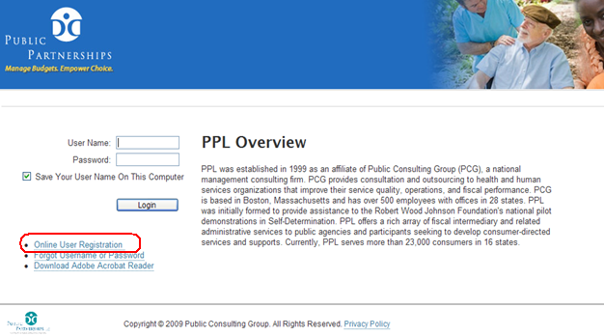
User Registration
To get set up your username and password, go to the e-timesheet portal page and click Online User Registration.

Slide 5
User Registration
Select:
The Program state (Massachusetts),
Program (MA Participant Directed Program), and
User Role (Either Provider Timesheet or Participant).

Slide 6
User Registration
If you are either a provider or a participant, you will see this screen.
Enter your last name, zip code and your social security number.

Slide 7
User Registration
On this page you will be asked to create a username and password.
Your password must contain at least one capital letter, one number, and one special character (such as *, #, !)

Slide 8
User Registration
You will also be asked to complete three security questions and to answer them. These will be used if your forget your password and to reset it in the future. Once you fill it out, click 'Submit' to complete the registration process.

Slide 9
Provider E-Timesheet Submission

Slide 10
Provider E-Timesheet Submission
Upon login, you will be brought to the Timesheets page.

Slide 11
Provider E-Timesheet Submission
If you have never submitted a timesheet before, you will not be able to search for any existing timesheets.
If you have submitted timesheets, you can view, edit, and delete existing timesheets here.

Slide 12
Provider E-Timesheet Submission
To enter a new timesheet, click 'Create Timesheet'.

Slide 13
Provider E-Timesheet Submission
Once you have clicked the 'Create Timesheet' link, you will be brought to the 'participant search' page.
Here you will see the list of participants you are working with.
Locate the participant you'd like to submit a timesheet for, and click 'Create Timesheet.'

Slide 14
Provider E-Timesheet Submission
You are now ready to create your timesheet.
Click on the Calendar icon and choose one of the dates for which you would like to submit time worked.
(Do not worry about selecting the correct payroll period; the E-timesheet system will identify the appropriate payroll date range for you.)

Slide 15
Provider E-Timesheet Submission
You are now in the timesheet entry page.
Here is where you can enter all of your hours worked during a two week pay cycle period.
By using the dropdown box above, you may select a ‘common service’ to bill for the entire timesheet. If you will be billing for multiple services, leave the dropdown box as is.

Slide 16
Provider E-Timesheet Submission
You can use the <tab> button or your mouse to move between the different boxes.
Using the ‘Service’ dropdown field, select the service that you will be billing for that day.
Then, select the ‘time in’ and ‘time out’ (the hours) that you worked that day.

Slide 17
Provider E-Timesheet Submission
If you worked more than one shift on a particular day, enter the first shift worked and click ‘there are more hours’; a new line will be added.
You may submit for multiple different services on each day. Simply select a new service code on the new line that appears for that day.

Slide 18
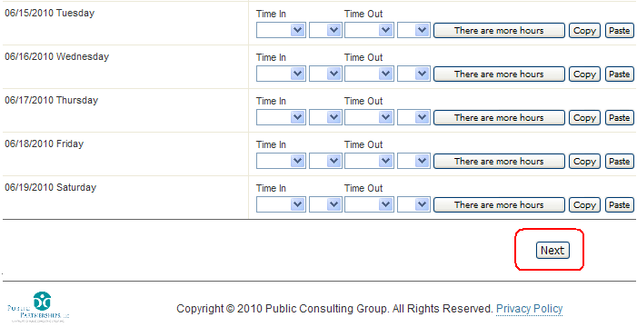
Provider E-Timesheet Submission
Once you finish filling out your timesheet, click to continue with submission.

Slide 19
Provider E-Timesheet Submission
Please review and confirm that everything entered into your timesheet is correct. If there are no changes, click
If you need to make changes, click

Slide 20
Provider E-Timesheet Submission
You have successfully submitted your timesheet to PPL, but you must have your timesheet approved by the participant.

Slide 21
Provider E-Timesheet Submission
To print your submitted timesheet and offer it to your employer to sign and fax to PPL, click on the Show printable version (PDF) button

Slide 22
Provider E-Timesheet Submission
Click ‘Save’ and your timesheet will appear as a PDF in a new window.
You can then print the timesheet, have it signed by your employer, and then fax it to the PPL timesheet fax number.
Alternatively, your employer can log in with his/her own user account and approve the timesheet online instead of via

Slide 23
E-Timesheet Approval Options
Participants are responsible for approving timesheets for hours worked by providers.
Option 1: Providers will bring the participant he or she works for a paper copy of his or her submitted E-Timesheet. The participant can review, sign, date and fax this timesheet to the PPL timesheet fax number
Option 2: Participants can create your own user account for E-Timesheet approval. With this, participants can log in and approve timesheets online (The next few pages will give instructions how to do this).

Slide 24
Participant E-Timesheet Approval

Slide 25
Participant E-Timesheet Approval
As a participant, when you log into the PPL Web Portal, you will be brought to the Timesheet List page.
Here, you will be able to review, approve and reject timesheets submitted by your providers.

Slide 26
Participant E-Timesheet Approval
Click to review and complete the processing of a timesheet.

Slide 27
Participant E-Timesheet Approval
Review the provider’s submitted hours.
If all the hours are correct, click

Slide 28
Participant E-Timesheet Approval
If the time submitted is incorrect, scroll down to the ‘Reject’ box and select a rejection reason.
After you have selected up to two reasons, click

Slide 29
Participant E-Timesheet Approval
The timesheet has now been approved.

Slide 30
Timesheet Status Messages
What do different status messages on the Timesheet List page mean?
Submitted – The provider has submitted the timesheet. It has passed program rules, and is awaiting participant approval
Good To Pay – The timesheet has been approved and is ready to pay
Approved – timesheet has been approved by the participant.
Rejected – The timesheet has been rejected by the participant
In Progress – PPL is processing the timesheet for payment
Denied – timesheet (in case of faxed timesheet) has not passed program rules and is pending. Customer service will be in touch with participant or provider if necessary.
Paid – timesheet has been paid. Please expect EFT or check payment within regular waiting time from date of payment
Pending – timesheet is currently being processed for payment. Status should change to Paid on the payroll Friday.

Slide 31
Participant Budget Summary

Slide 32
Participant Budget Summary
To view the Budget Summary, which includes information about current spending, service authorizations, and available funding, click the ‘Budget Summary’ tab at the top of the page.

Slide 33
Participant Budget Summary
On the ‘Budgets’ page, the user can see the overall budget for the fiscal year.
To view more details on services and dollars used, click ‘Budget Detail’.

Slide 34
Participant Budget Summary
On the budget summary page, Participant services, dollars paid and dollars available are all viewable in real time.
The ‘invoiced’ column also shows timesheets that are currently received by PPL, are in process and have not been paid yet.

Slide 35
Participant Budget Summary
You can click the ‘Display Detail’ button to view more details for each service authorization.

Slide 36
Participant Budget Summary
You can click ‘Show Detail’ to see spending and invoiced items in real time.

